Slide 1
502045
Software Engineering
Chapter 06
Lesson 07: Implementation Issues

Slide 2
IMPLEMENTATION ISSUES
A critical stage of software development process is system implementation where you create an executable version of the software
Implementation may involve developing programs in high- or low-level programming languages or
Tailoring and adapting generic, off-the-shelf systems to meet the specific requirements of an organization;

Slide 3
IMPLEMENTATION ISSUES
Reuse: Most modern software is constructed by reusing existing components or systems.
Configuration management: keep track of software components’ versions
Host-target development: development computer (the host system) vs execution computer (the target system)

Slide 4
REUSE
The abstraction level: At this level, you don’t reuse software directly but rather use knowledge of successful abstractions in the design of your software.
The object level: At this level, you directly reuse objects from a library rather than writing the code yourself.
The component level: Components are collections of objects and object classes that operate together to provide related functions and services
The system level: At this level, you reuse entire application systems.

Slide 5
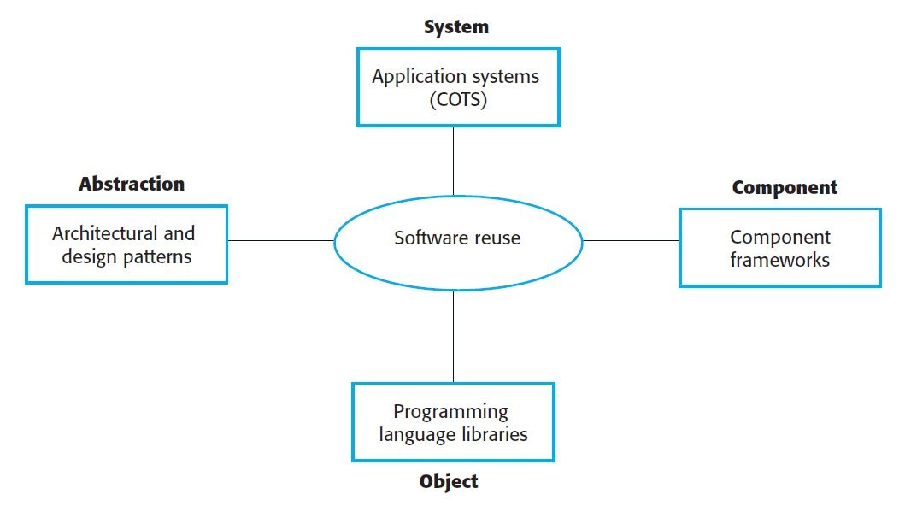
REUSE

Slide 6
REUSE COSTS
The costs of the time spent looking for software to reuse
The costs of buying the reusable software
The costs of adapting and configuring the reusable software components or systems
The costs of integrating reusable software elements with each other

Slide 7
CONFIGURATION MANAGEMENT
Configuration management is the general process of managing a changing software system
The aim of configuration management is to support developers:
Access the project code and documents in a controlled way
Find out what changes have been made
Compile and link components to create a system

Slide 8
CONFIGURATION MANAGEMENT
Version management: keep track of the different versions
System integration: define what versions of components are used to create system
Problem tracking: report bugs and other problems
Release management: plan the functionality of new releases and organizing the software for distribution

Slide 9
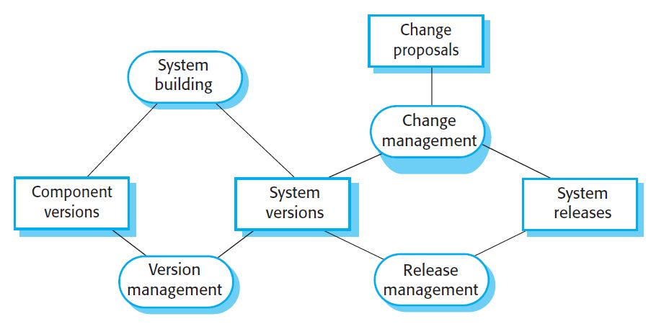
CONFIGURATION MANAGEMENT

Slide 10
HOST-TARGET DEVELOPMENT
Software is developed on one computer (the host) but runs on a separate machine (the target)
It is more than just hardware
It includes operating systems plus other supporting software such as a database management system

Slide 11
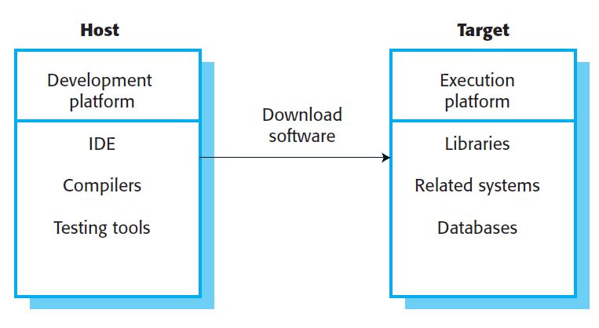
HOST-TARGET DEVELOPMENT

Slide 12
SOFTWARE DEVELOPMENT PLATFORM
An integrated compiler and syntax-directed editing system
A language debugging system
Graphical editing tools, such as tools to edit UML models
Testing tools, such as Junit
Tools to support refactoring and program visualization
Configuration management tools to manage source code versions and to integrate and build systems.

Slide 13
TARGET PLATFORM
The hardware and software requirements of a component
The availability requirements of the system
Component communications

Slide 14
Q&A

